Slide 1

Case Study 1

Slide 2
Objectives
Build a model to identify the top 3 factors leading to attrition for Frito Lay.
Explore employee characteristics to identify and explain trends and observations from the data.
Build KNN and NB models to predict attrition.
Notes:
Don’t read objectives during presentation. More conversational

Slide 3
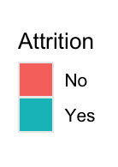
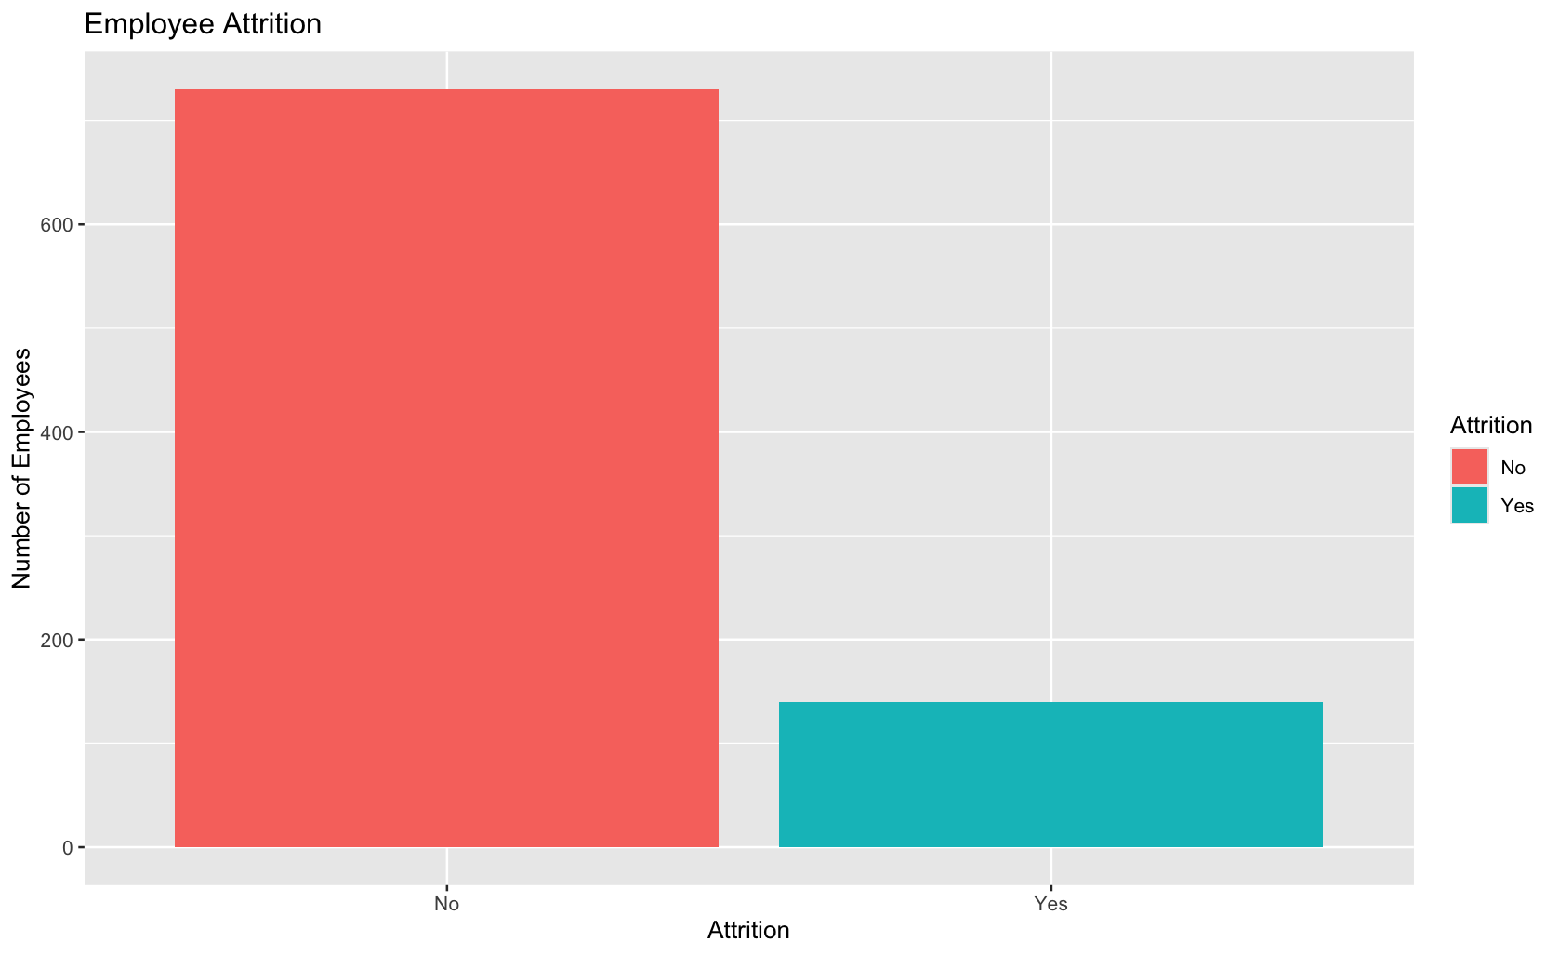
Frito Lay Attrition
There were 870 employees in the given dataset.
16.09% of employees left the company (Labeled as Attrition).
 | Attrition | Not Attrition
Count | 140 | 730
Percentage | 16.09% | 83.91%
Notes:
Make attrition legend larger

Slide 4
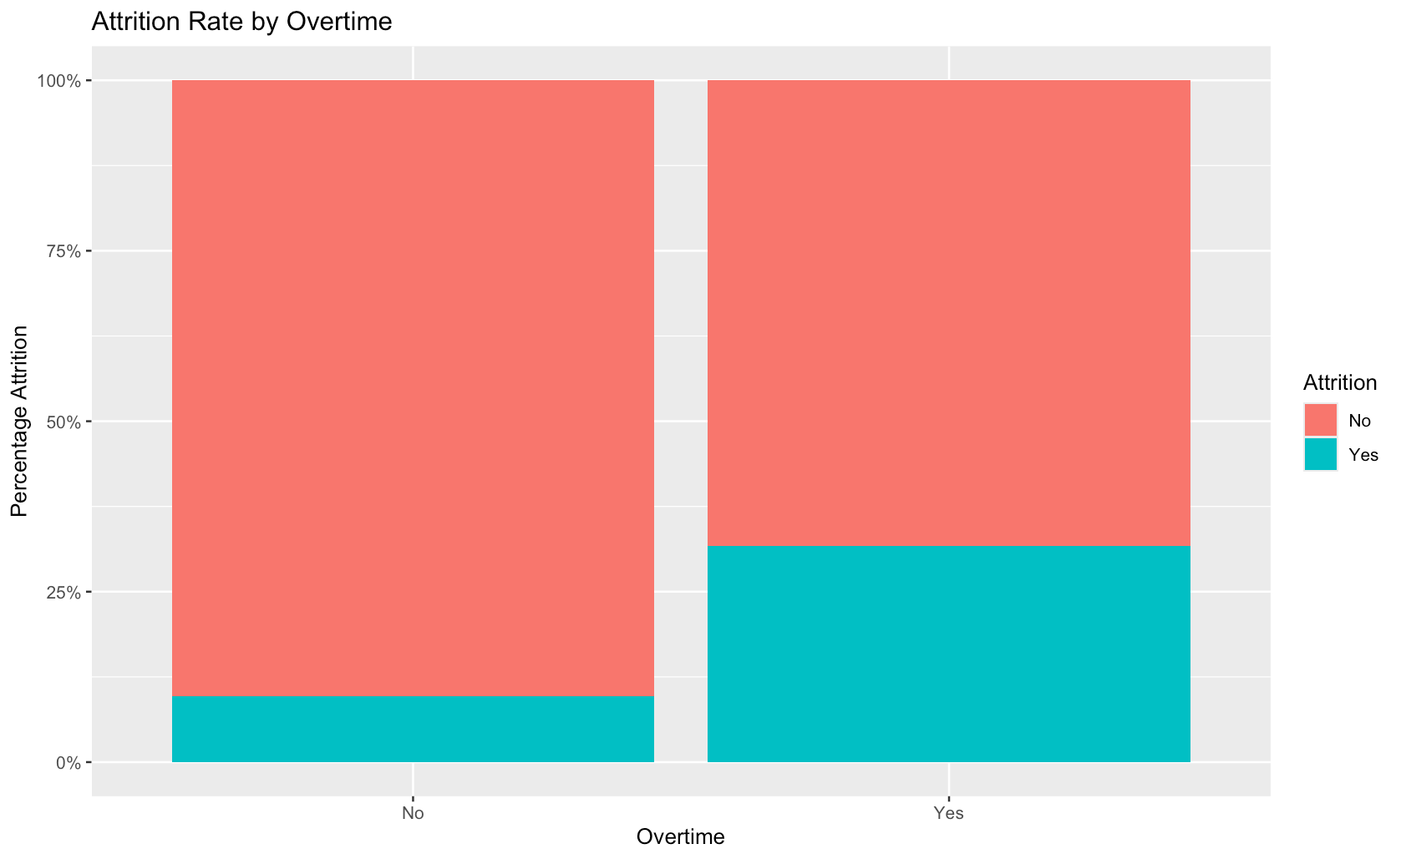
What factors may lead to Attrition?
I tested Overtime rates on Attrition.
I found that those who worked overtime were 3.27 times more likely to leave the company.
Notes:
Make 3 slides. 1 factor per slide

Slide 5
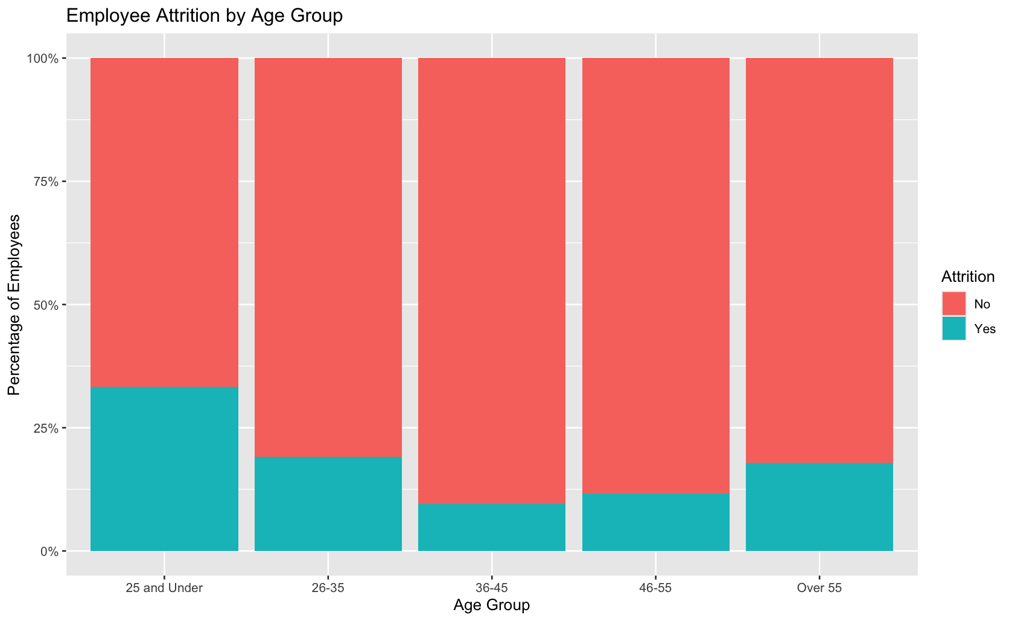
What factors may lead to Attrition?
I tested Age on Attrition.
The youngest age group was 1.87 times more likely to leave the company than the oldest age group.
The median age group of 36-45 years of age had the lowest percentage of attrition at 9.49%.

Slide 6
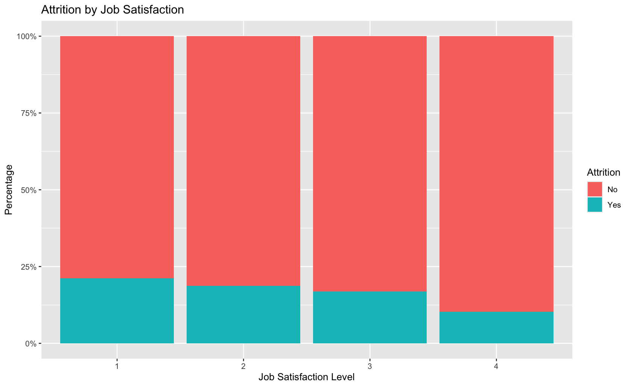
What factors may lead to Attrition?
I tested job satisfaction on Attrition.
Those with the lowest satisfaction scores were 2.06 times more likely to leave the company.

Slide 7
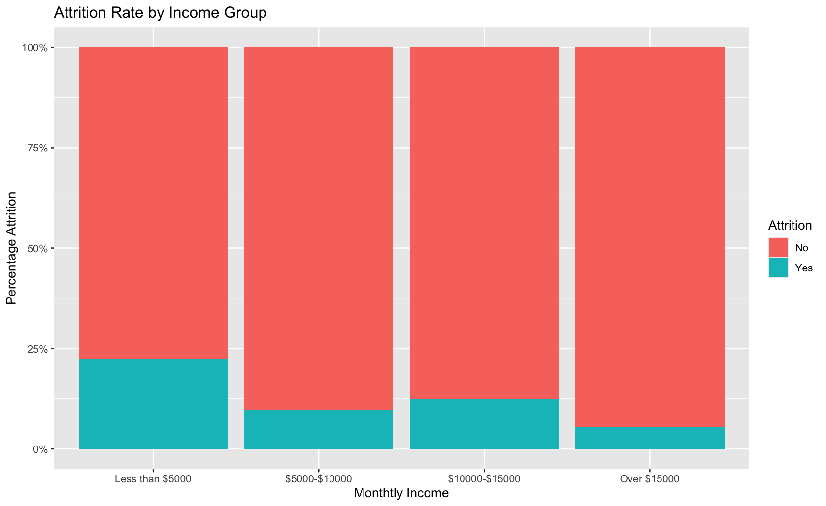
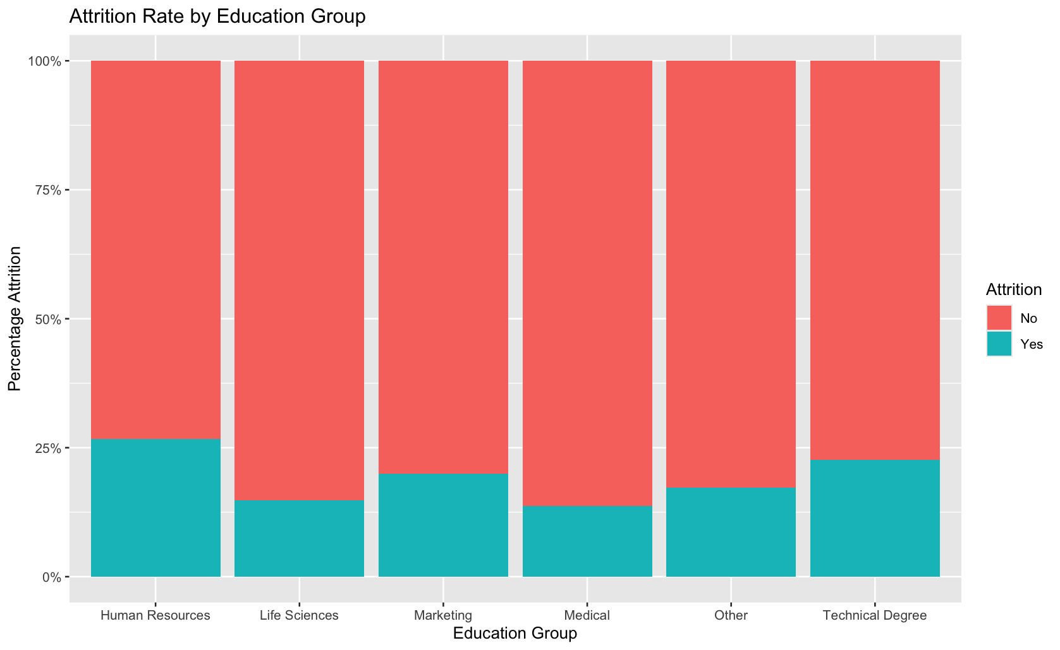
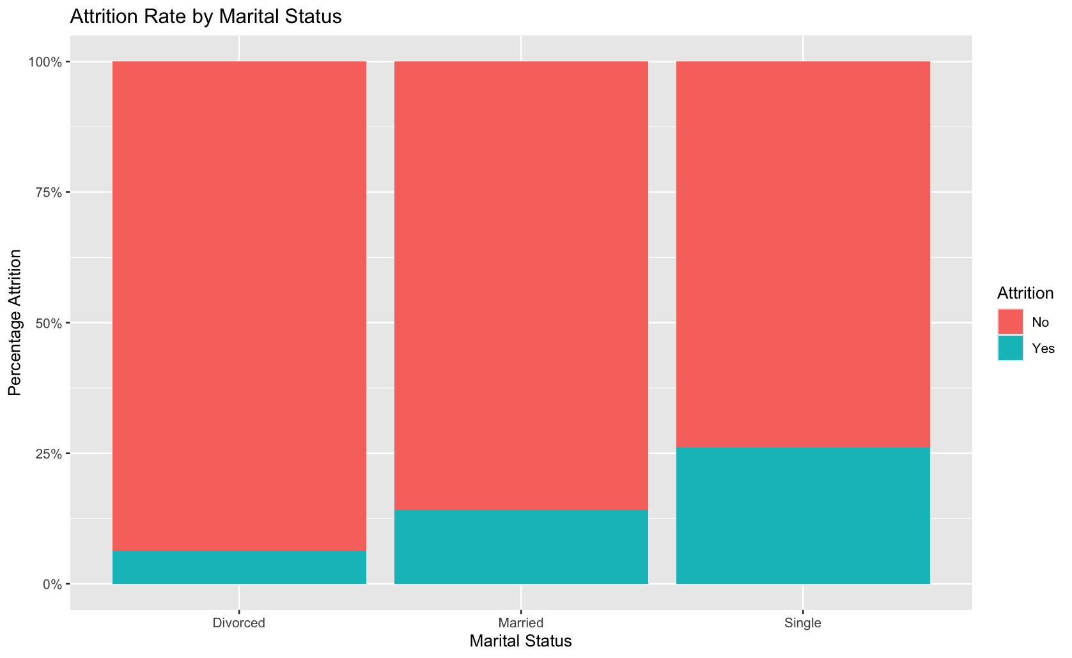
Additional factors that may lead to Attrition?
I tested Monthly Income rates on Attrition.
  The smallest income group was 4.2 times more likely to leave the company than the largest income group.
Human Resources was the education field with the highest amount of attrition at 26.67%.
  Medical was the education field with the smallest percent of attrition at 13.7%.
  1.95 times more likely for HR to leave compared to Medical.
Employees that were single were 4.14 times more likely to leave the company compared to employees that were divorced.
  26.02% attrition rate vs 6.28%.
Notes:
Keep as is. Remove legends

Slide 8
3 characteristics that account for largest differences in Attrition.
Monthly Income rates
  Employees that made less than $5000 a month were 4.2 times more likely to leave the company than those making over $15000 a month.
Marital status
  Single employees were 4.14 times more likely to leave the company than divorced employees.
Overtime rates
  Employees that worked overtime were 3.27 times more likely to leave the company than those that did not.
Notes:
Speak to slide before it comes on screen. Make text bigger

Slide 9
KNN
My KNN model confusion matrix gave the below results. Attrition is my positive value.
  My accuracy was 65.52%
  Sensitivity was 60.87%
  Specificity was 66.51%.
Notes:
Changed K to 39 and threshold to 15%

Slide 10
NB
My NB model confusion matrix gave the below results. Attrition is my positive value.
  My accuracy was 74.33%
  Sensitivity was 65.22%
  Specificity was 76.28%.
Notes:
Changed threshold to 17%

Slide 11
KNN vs NB
 | KNN | NB
Accuracy | 65.52% | 74.33%
Sensitivity | 60.87% | 65.22%
Specificity | 66.51% | 76.28%

Slide 12
Model comparison
NB outperformed KNN across all three metrics.
My sensitivities were both over 60%
  This is predicting employees that left the company.
My specificities were both over 66%
  This predicts employees that stayed at the company.

Slide 13
Costs associated 50% costs
Model | Total Cost | Potential Savings
No Model | $1,282,128 | $0
KNN | $693,212 | $588,916
Naive Bayes | $653,016 | $629,112

Slide 14
Costs associated 400% costs
Model | Total Cost | Potential Savings
No Model | $10,257,024 | $0
KNN | $5,405,696 | $4,851,328
Naive Bayes | $5,110,728 | $5,146,296

Slide 15
Findings
Both models show potential to reduce costs related to attrition; however, NB estimates more savings and less costs for retention.

